Slide 1
Equipment identification through image recognition
Darkhan’s Master thesis
Biweekly report

Slide 2
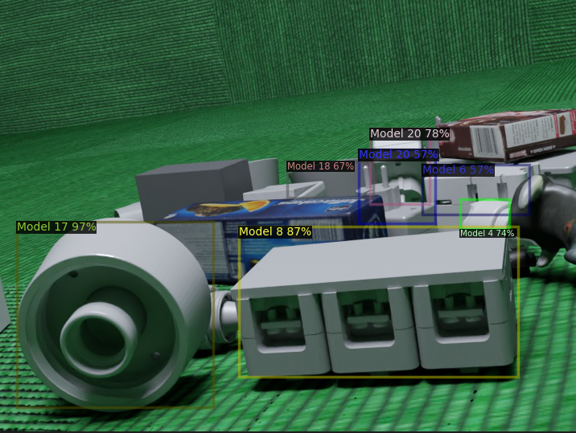
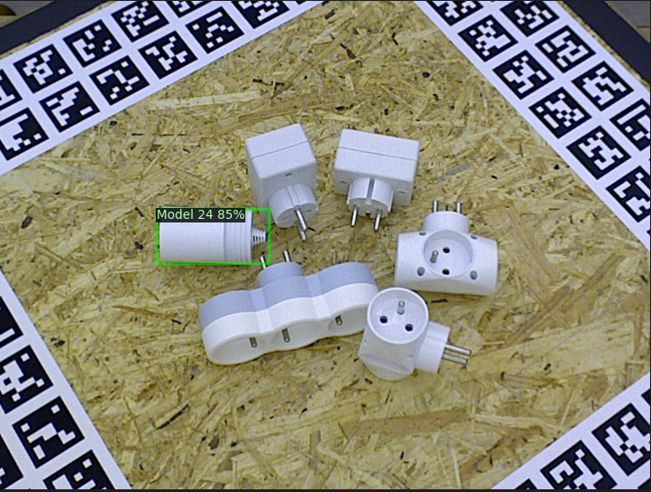
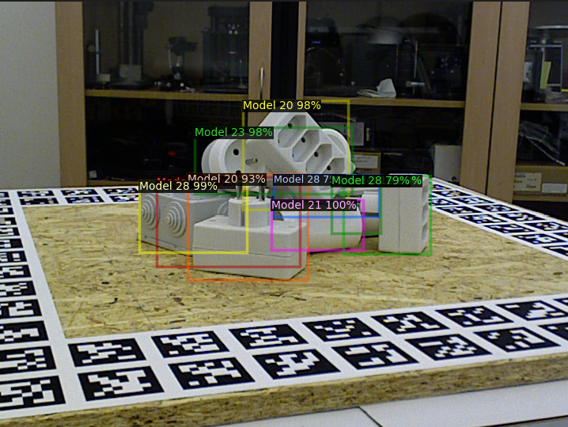
Detectron2
Average precision on test data
 | Model trained on rendered data and tested on rendered images | Model trained on rendered data and tested on real images | Model trained on real data and tested on real images
Detectron2 with faster_rcnn_R_50_FPN_3x backbone model | AP - 64.3510 AP50 - 76.0020 AP75 - 72.4191 | AP - 9.0097 AP50 - 13.6304 AP75 - 10.046 | AP - 83.3187 AP50 - 98.1990 AP75 - 94.2122
BASE_LR: 0.00125
MAX_ITER: 20000
NUM_CLASSES: 30
85/15% test/train split
Total rendered images: 50 000
Total real images: 10 000
Training time < 1 hour on Nvidia A100 (YOLOv4 in comparison took > 16 hours)
https://github.com/facebookresearch/detectron2

Slide 3
Detectron2
Conclusion
The model overfits and needs longer training with different parameters
Most certainly the domain shift phenomenon is happening

Slide 4
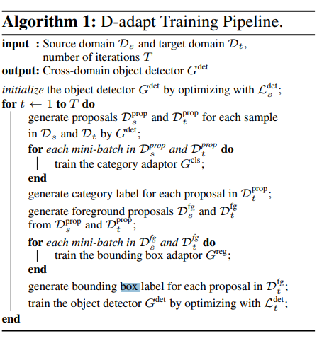
Domain adaptation
Decoupled adaptation for cross-domain object detection
Based on detectron2 with faster_rcnn_vgg_16 backbone
No visual example ready yet
Results:
(4h of training on source, then 4h on target dataset)
 | Test on source data | Test on external (real data)
Model trained with only rendered data | AP 59.39 (AP50 - 74.10, AP75 – 67.93) | AP 6.77 (AP50 - 13.83, AP75 – 5.79)
Model trained on rendered data and adapted to real | AP 57.69 (AP50 - 73.11, AP75 – 67.01) | AP 36.85 (AP50 - 64.32, AP75 – 38.02)
Decoupled adaptation for cross-domain object detection

Slide 5
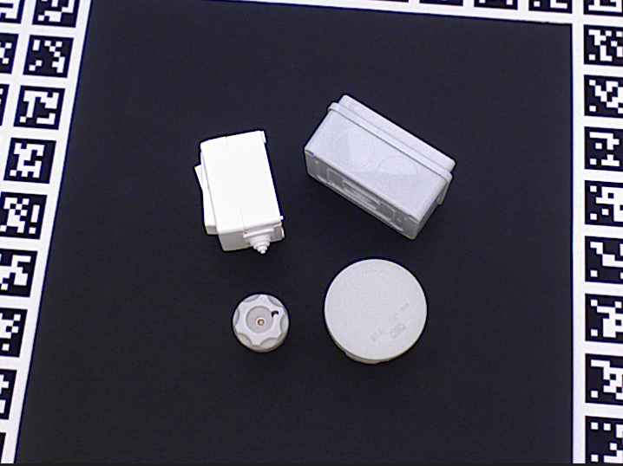
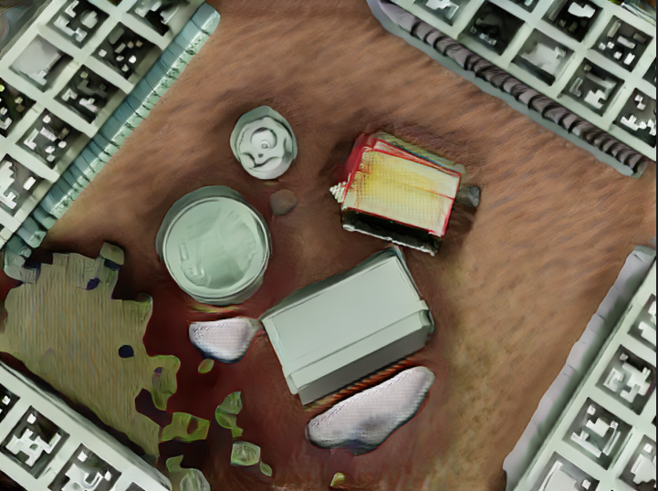
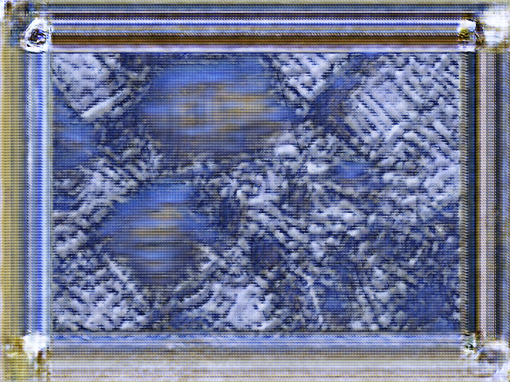
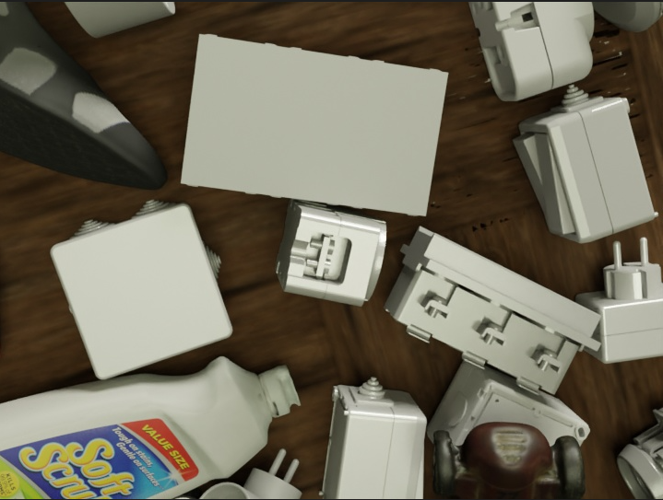
Domain adaptation
Progressive Domain Adaptation for Object Detection (in progress)
Steps:
Generate intermediate domain (CycleGAN network used below)
Adapt on synthetic images with pseudo-labels from original data– not yet tested
Results (36 hours of training(44 epochs) on the same dataset):
Real image | Real image that looks like rendered | Rendered image that looks like real (fail) | Rendered image
Source: Progressive Domain Adaptation for Object Detection (arxiv.org)

Slide 6
Questions:
What could be the reason for failed synthetic images?
What would be the theoretical limit for number of classes to detect in an object detection problem?
Scope of the thesis
Suggestions?

